Slide 1
ISOnet Redesign
Design Patterns

Slide 2
Purpose of this Document
The purpose of this document is to specify User Interface design patterns for use in ISOnet and its related products. Design patterns are a set of solutions to common user interface problems. Examples in this document are based on a clickable prototype of the ISOnet portal and the Emerging Issues portal. Please refer to the prototype for exact pixel dimensions and interaction behavior.
The majority of pages in the current implementation of ISOnet fit within one of the defined patterns in this document. Other pages that fall outside of these patterns will adopt styles such as fonts, colors and control styles, that will keep it consistent with the new design. However these outlier pages will require independent design attention in regards to page layout and application flow. Examples for style adoption are given at the end of this document
Notes:
Based on who we target, I will need to know how to get to these users. The ISOnet redesign conducted a focus group in Dec. Something similar?

Slide 3
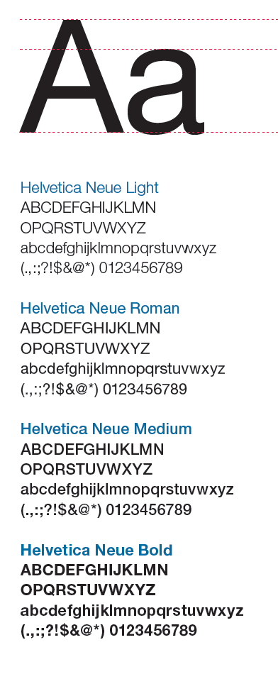
Branding Guidelines
The ISOnet design will follow the latest brand guidelines supplied by Verisk Analytics – Corporate Marketing. These guidelines include typography, logo usage, and color palette. For more information on Branding Guideline, contact Verisk Design Services.
Font stack for digital media:
Helvetica Neue
Helvetica
Arial
Sans-serif
Verisk Design Services has supplied various sizes of the approved logo, so there should generally be no need to enlarge or reduce the logo. Enlarging or reducing the logo on your own could stretch or distort the logo. If you need a custom size, contact Verisk Design Services.

Slide 4
Color Palette
The ISOnet color palette is derived from the latest brand guidelines supplied by Verisk Analytics – Corporate Marketing. For more information on Branding Guideline, contact Verisk Design Services.
Primary colors
Expanded color palette
ISOnet color palette
Body text
#777 – dark gray
Hyperlink text (on dark backgrounds)
#4cc6f3 - light blue
Hover
#1E4664 – dark blue
Hyperlink text (on light backgrounds)
Default buttons
#0177A9 - blue
Emphasis button
#FFA400 – orange/gold

Slide 5
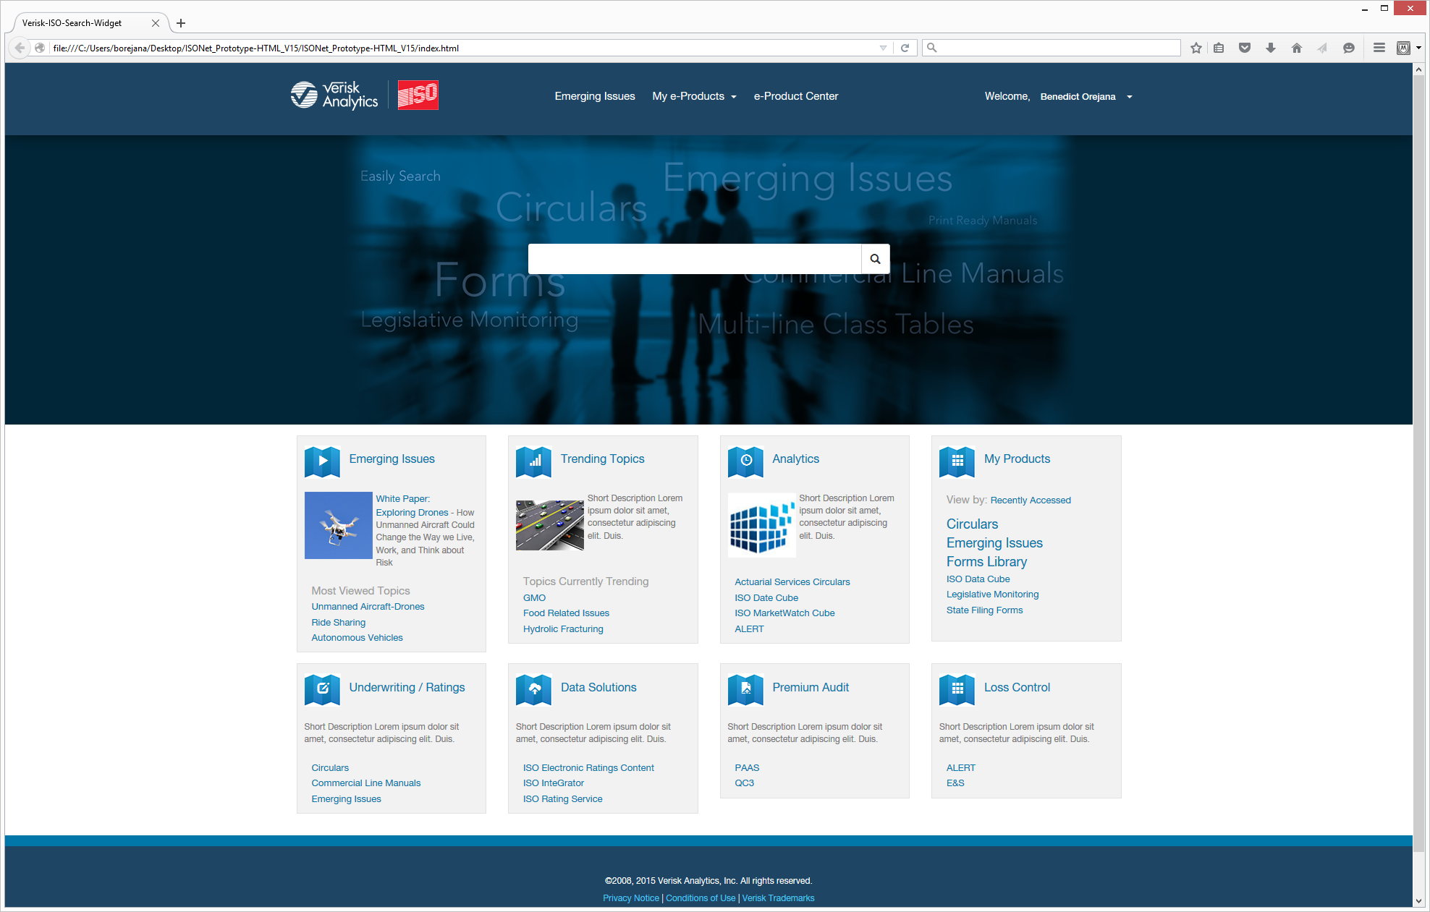
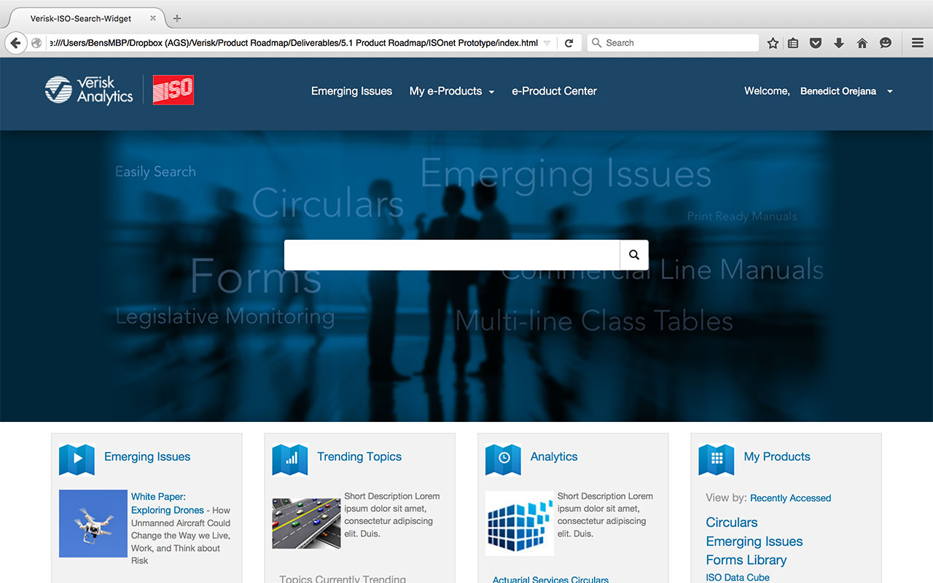
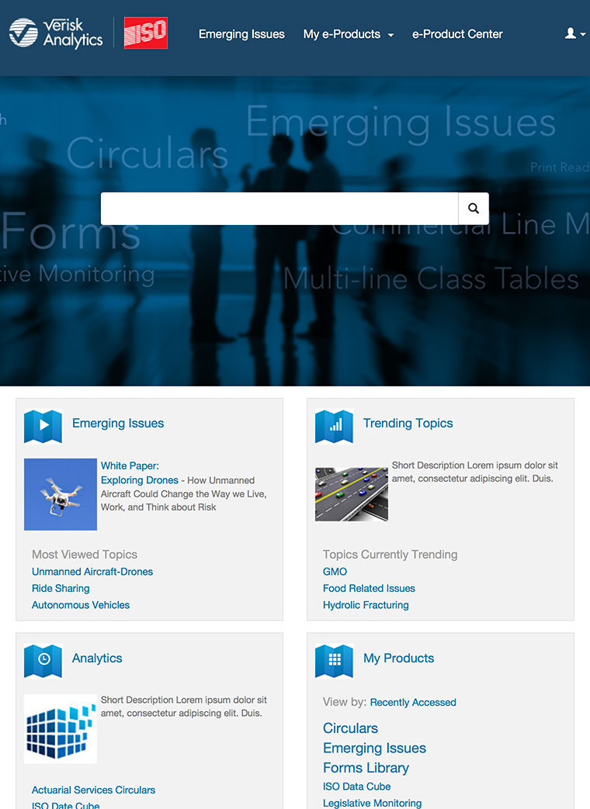
Screen Resolution
Site pages should be designed to adjust to optimal resolutions for desktops, laptops and tablet screens with the following breakpoints:
Widescreen: 1920px x 1080px (most desktop screens)
Normal: 1280px x 800px (most laptops)
Narrow: 786px x 1024px
(tablets)
Notes:
Prototype breakpoint set at W:768

Slide 6
Headers and Footers
The header serves as a global navigation accessible not only on ISOnet but also all of its associate e-Products. Users can easily access their e-Products (1) as well as their user info (2) On page scroll, the header will shrink in height from 85px to 75px (3). If a global search box is not prominent on the main content page, then the global search icon (4) will appear in the header. Clicking on the icon will expand the search input field (5). Select areas and e-Products on ISOnet will also include a sub-navigation as part of the header (6).
All pages on ISOnet will include a standard footer (7) with boilerplate information and links to legal terms and agreements.
Header/footer background dark blue
#1E4664
1
2
3
85px
4
75px
5
6
Subnav background blue
# 0177A9
7

Slide 7
Link Elements
Both text hyperlinks and buttons follow similar color scheme as follows:
Hyperlinks
Footer hyperlinks
Buttons
Hyperlink (active)
#0177A9 - blue
Hyperlink (hover)
#1E4664– dark blue
Body text
#777 – dark gray
Hyperlink (active)
#4cc6f3 - light blue
border-radius: 4px
Default buttons
#0177A9 - blue
Hover
#1E4664 – dark blue
Emphasis button
#FFA400 – orange/gold
Notes:
Verisk Health
Action Buttons
#FFA400 – orange/gold
#0076A9 – blue
#4CC6F3 – Light Blue font

Slide 8
Page & Link identification – icons and labels
Proper page and label naming can help improve usability for both end-users and developers. The following are elements to consider setting and adhering to an agreed upon naming convention.
Page <title tag>
These tags serve as the title to each page and are displayed in a browser tab. Use care to use essential wording when naming a page. Using the pages function or purpose is more helpful than describing the pages location. Example: Use “White Paper: Drones” instead of “ISOnet / Emerging Issues / Drones / White Paper”
Page file name
Page file names are more for developers than users. However, being descriptive and consistent with naming conventions can help reduce confusion. Example: Emerging_Issues_Home.html rather than home.html
Fav icon
The fav icon serves as the sites logo. Using a distinct icon can help users identify your page among other tabs without having to rely on the full page title
Link labels
– Be descriptive
– Full words instead of acronyms for unknown acronyms
Icon link combo / toolbars
If you use icons for certain command such as export or upload, use common icons that are familiar to users. If possible provide a label next to the icon customary in most toolbars. If space is limited, provide a mouse-over tool-tip

Slide 9
Graphic Elements
Photo images should be properly licensed and cleared for use by Verisk Design Services. Images used to serve as a primary page banner image should be screened into a monotone Verisk blue (#012638) to provide sufficient contrast with other banner elements such as the search input field or news panel.
Simple line icons should be used as graphic elements to accompany description text or to accent an editorial piece. The same icon types should be used for tool icons and indicators such as search or download.

Slide 10
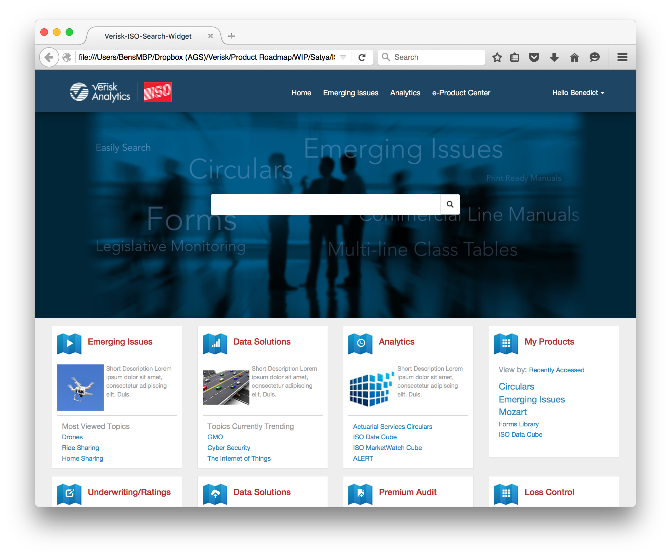
Landing pages (primary and secondary)
Primary and secondary landing pages utilize a banner (1) image typically consisting of approved photo images screened in Verisk blue. The image should scale accordingly with a dark blue background color fade into the photo edges. The photo should not have hard edges.
Content used in the banner may vary per page. The ISOnet home page emphasized Global Search, where the Emerging Issues Portal will list the latest news feeds.
Content below the banner image (2) will be displayed as either 4 or 6 column panels that flow beyond the fold (below the visible screen). Content within these panels will vary based on the nature of the page. Some examples include: Announcements, latest news, product listings, topic sections etc.
1
500px
Banner
background
# 012638
2

Slide 11
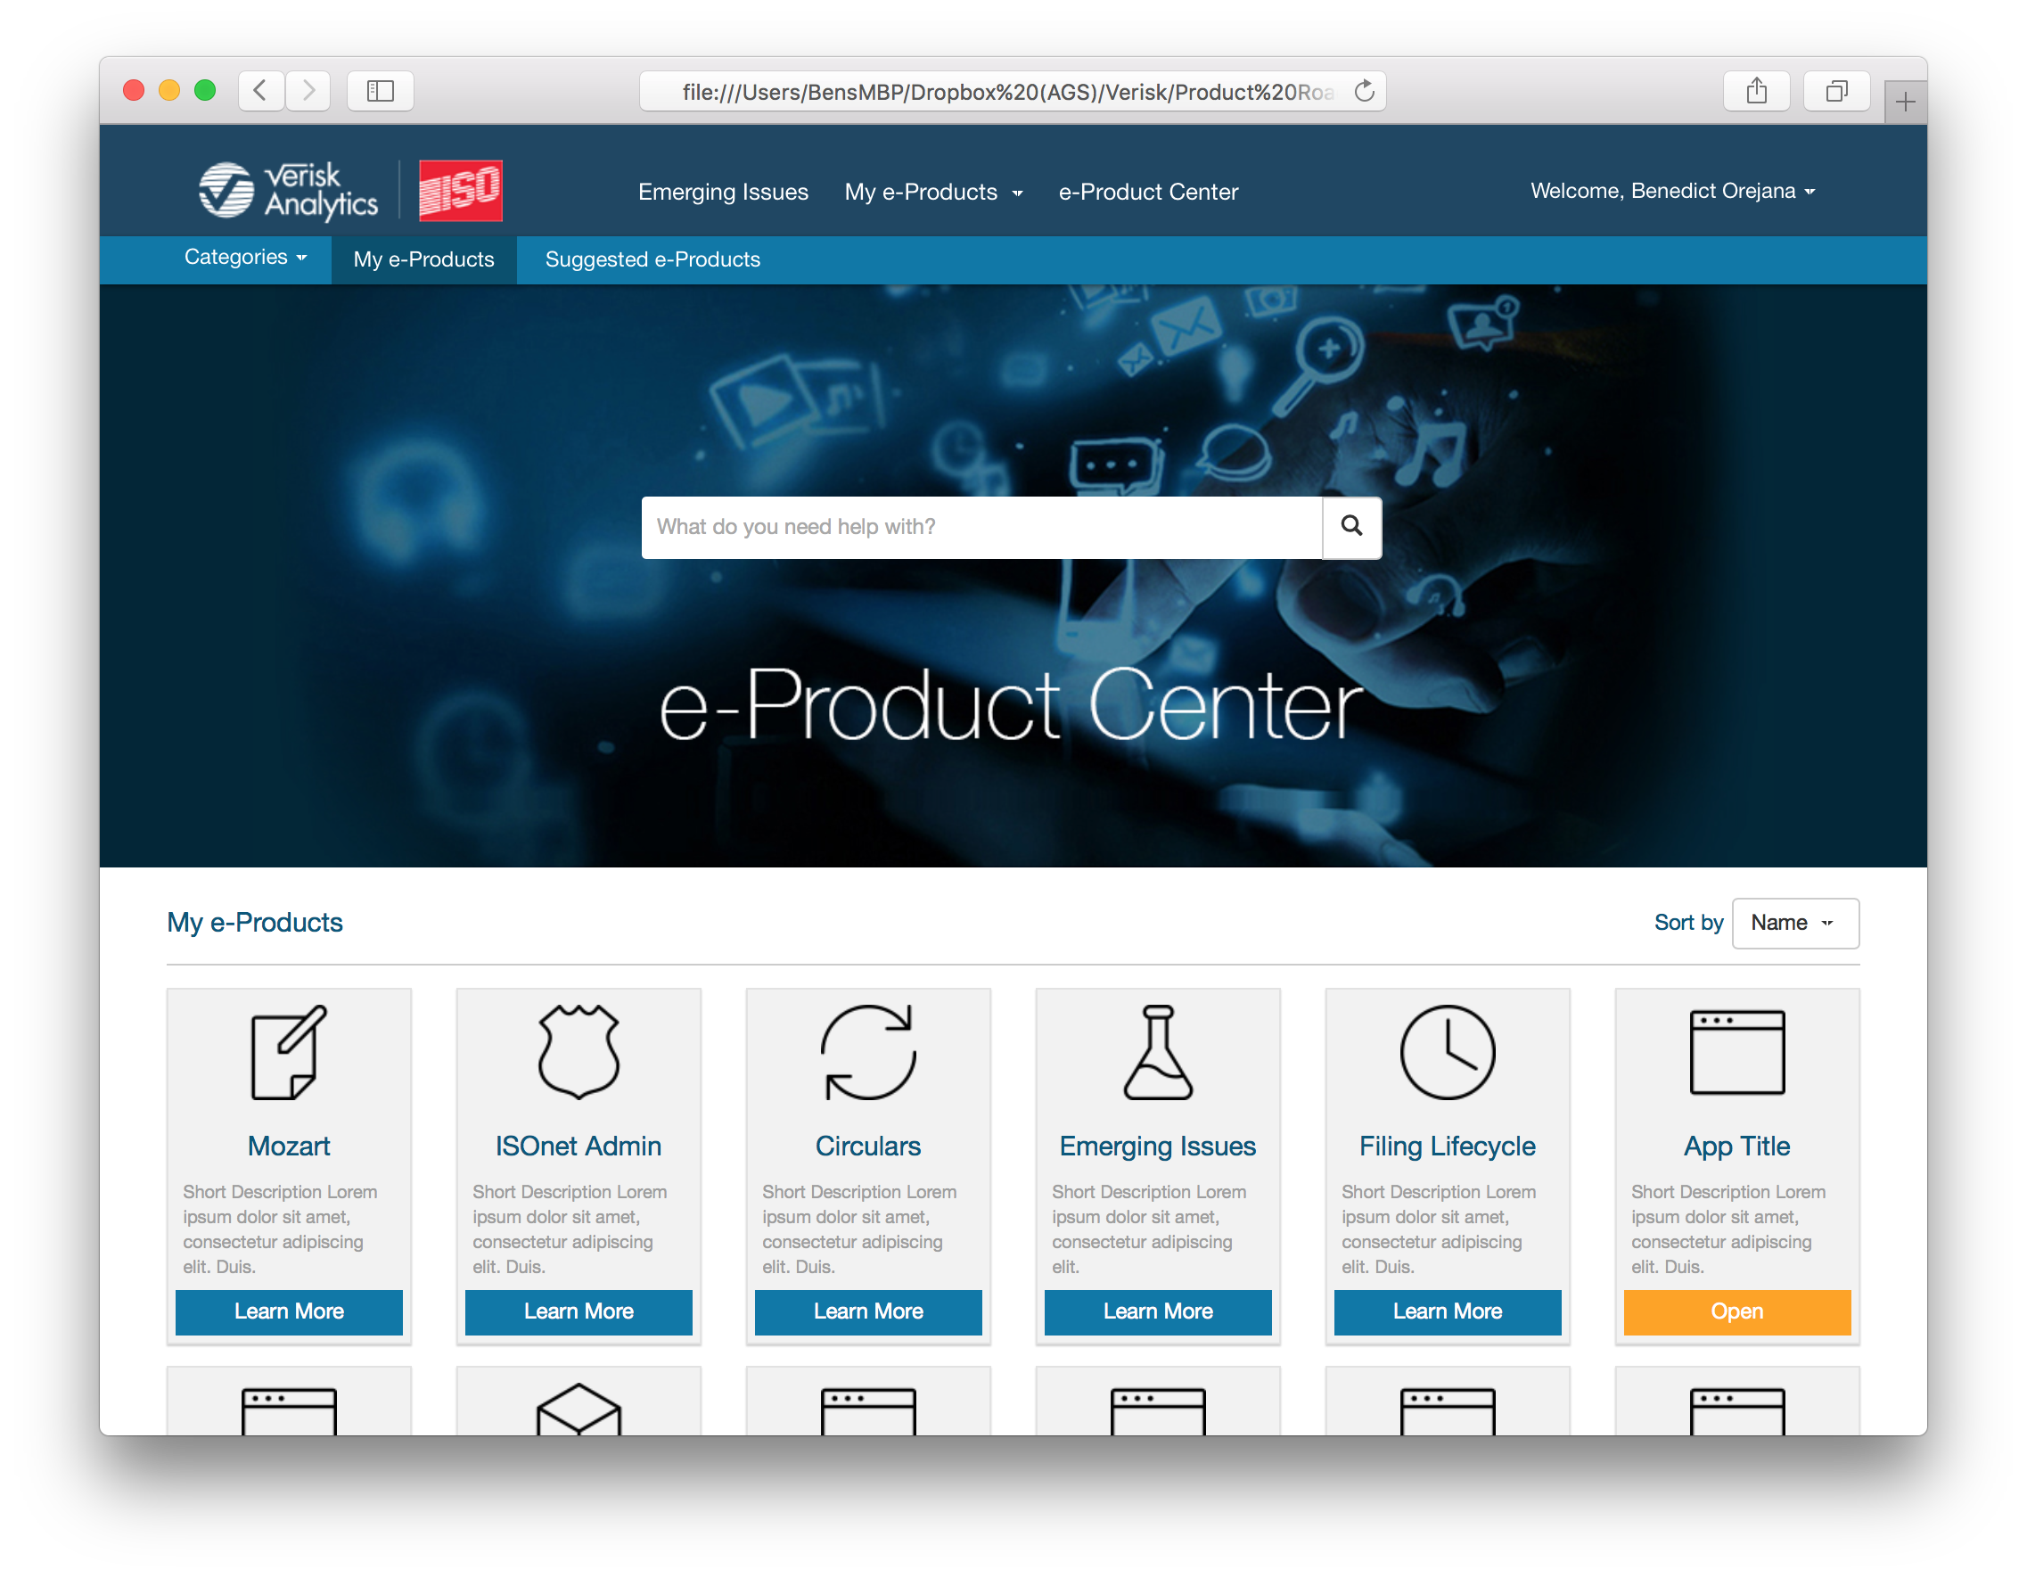
Landing pages (4 and 6 column examples)
4 column
6 column

Slide 12
Content Page - Article
Content pages will have a blog-like layout consisting of a left-navigation (1) to serve as links to sections or table of content and a main content area (2)
A breadcrumb navigation at the top of the content (3) will help the user stay oriented to their current location in ISOnet.
3
1
2

Slide 13
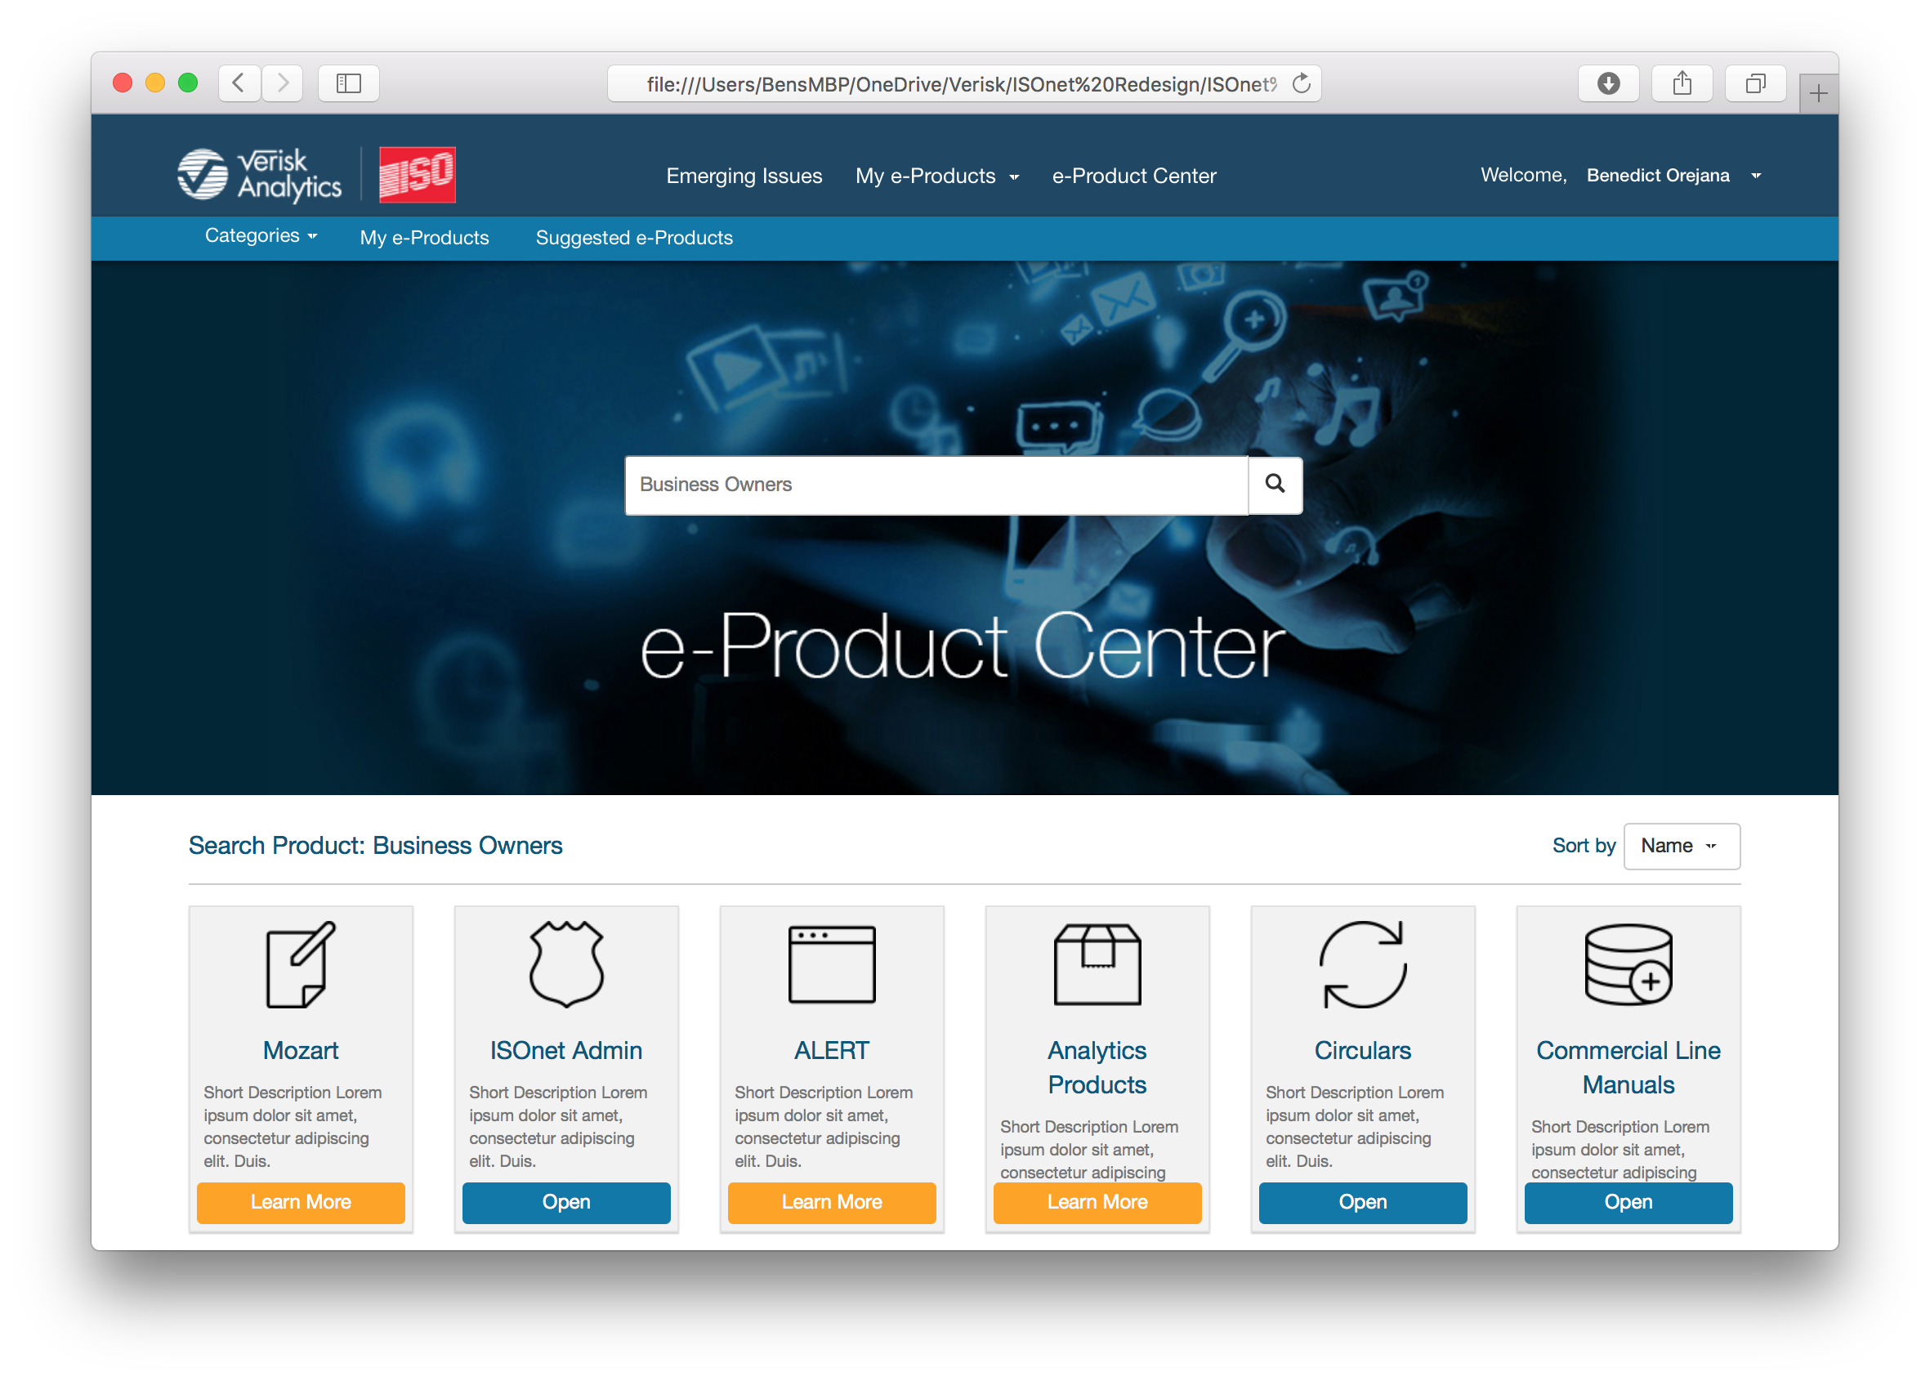
e-Product Center
The e-Products page utilizes the same layout as Landing pages. A e-Product search box (1) allows the user to search products related to terms they enter in the search box such as analytics, business owners, underwriting etc.
e-Product listings (2) are displayed in a 6 column panel layout. Narrow panels allow more products to be listed per row.
e-Product panels distinguish user access by either displaying an “Open” button (3) for those application purchased by the user or “Learn More” (4) for products that are not part of the user’s current entitlement.
Clicking on Open will launch the Application. Clicking on Learn More will display the e-Products details panel.
By default, My Products are shown when entering the e-Products Center from the global navigation
1
2
3
4

Slide 14
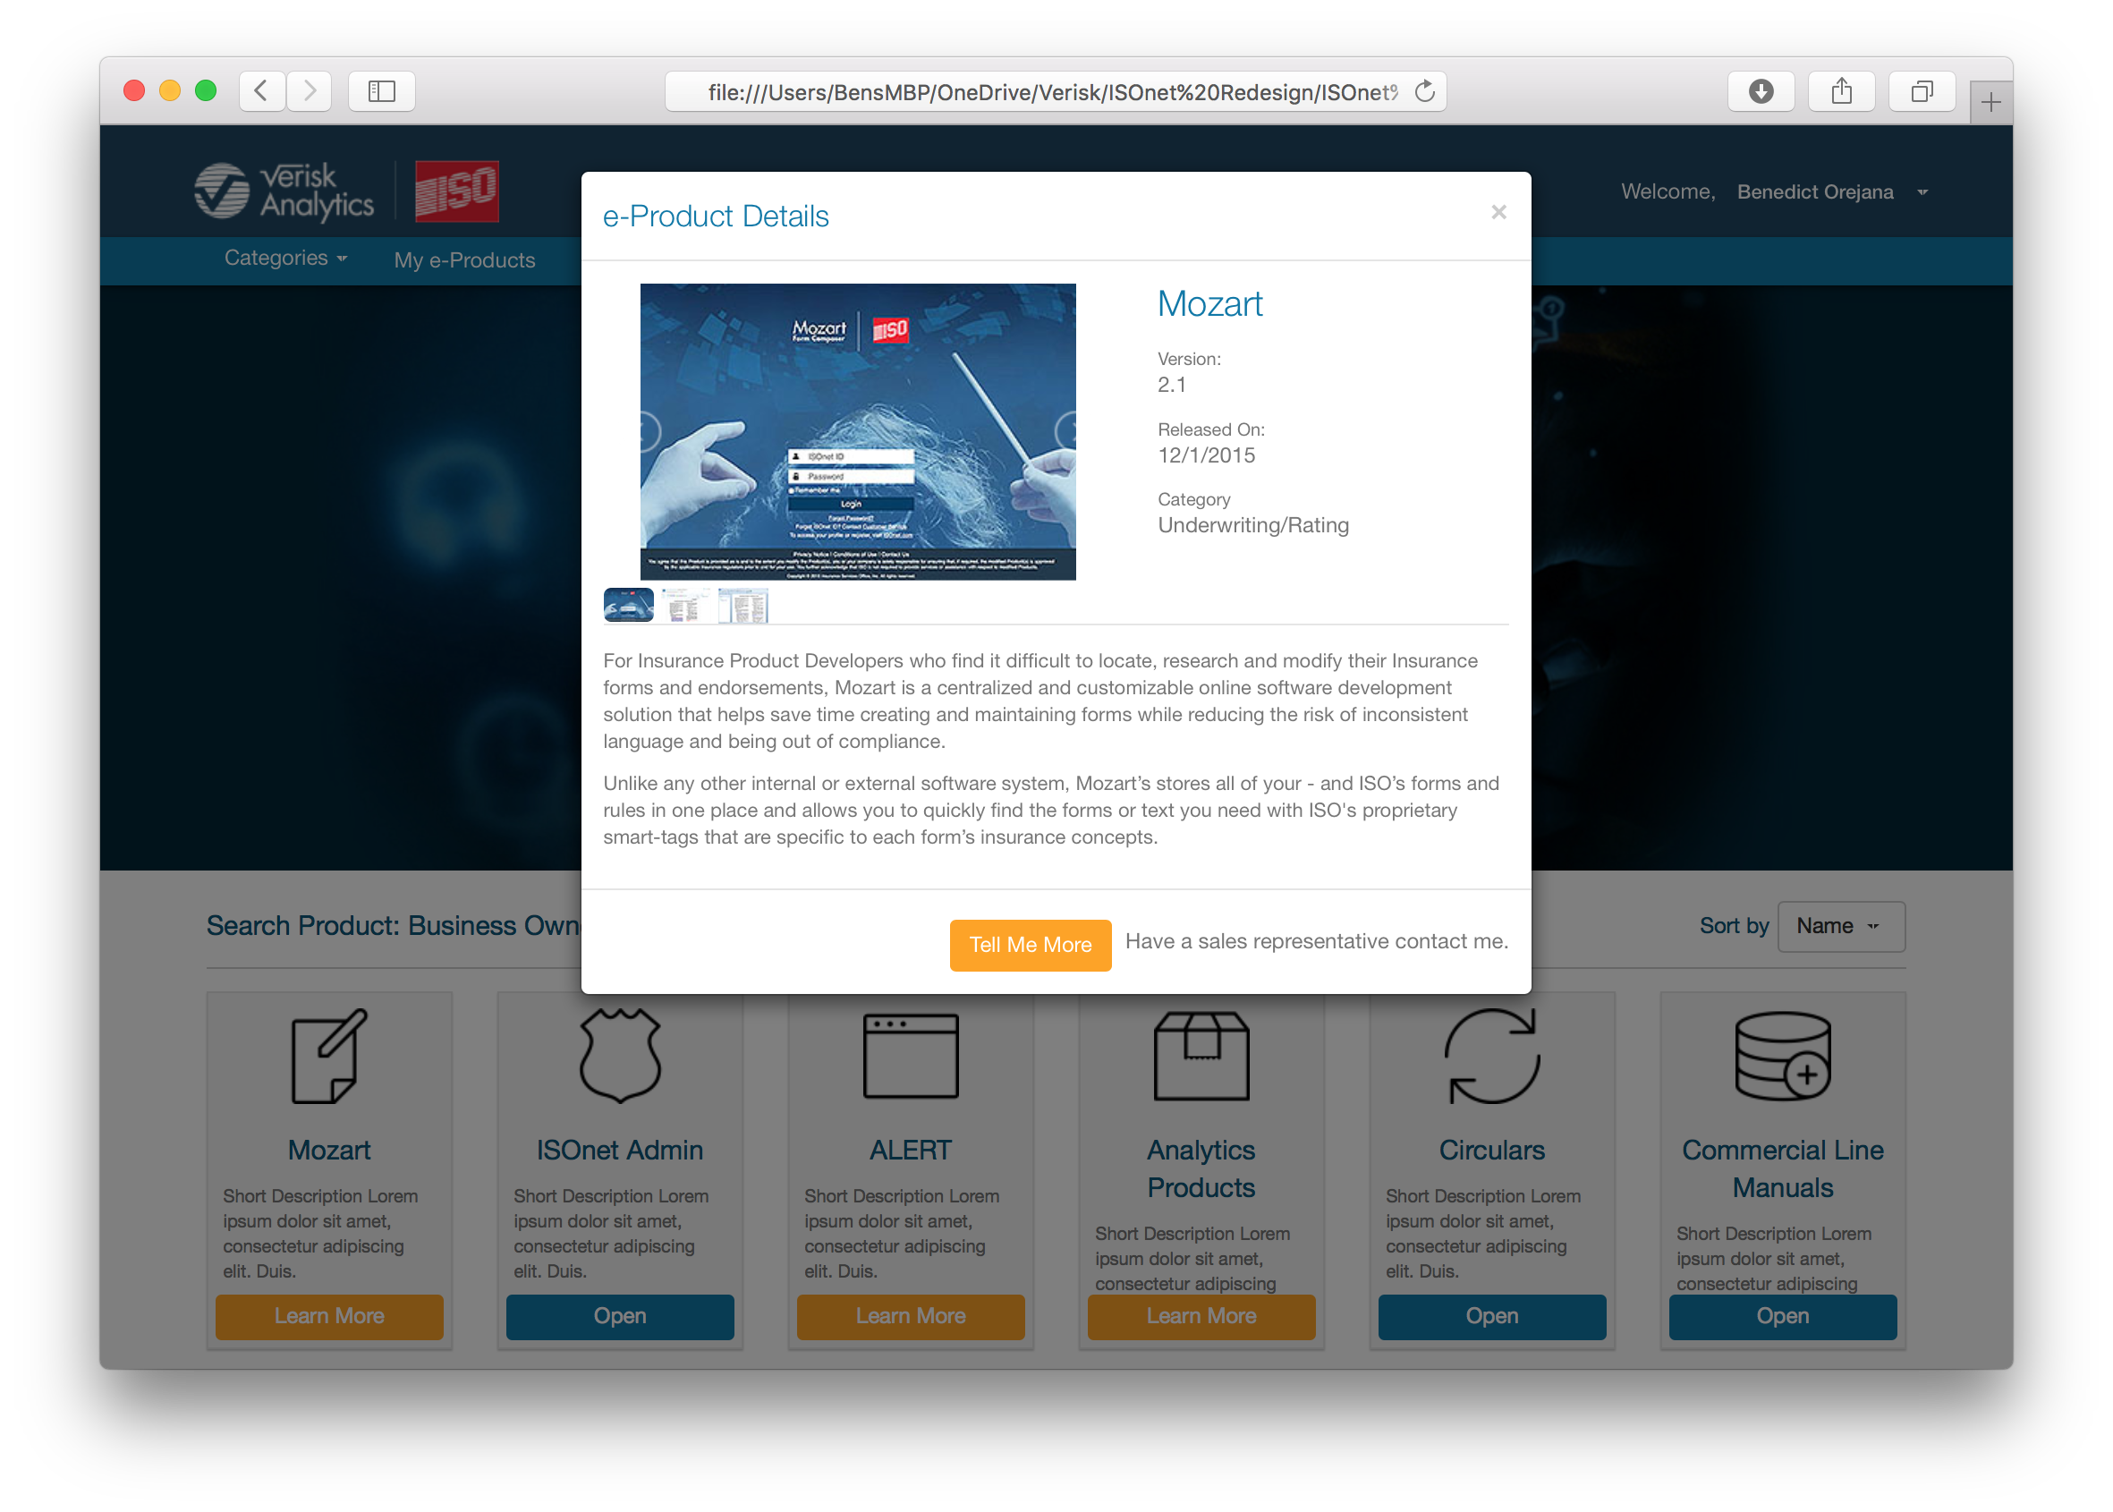
e–Product Details panel
Clicking on Learn More will display the e-Products details panel in a modal window.
The details page allows the user to read a detailed description of the e-Product as well as view screen shots through an image carousel (1). If interested, the user can reach out to a sales representative by clicking the “Tell Me More” call-to-action button (2)
1
2

Slide 15
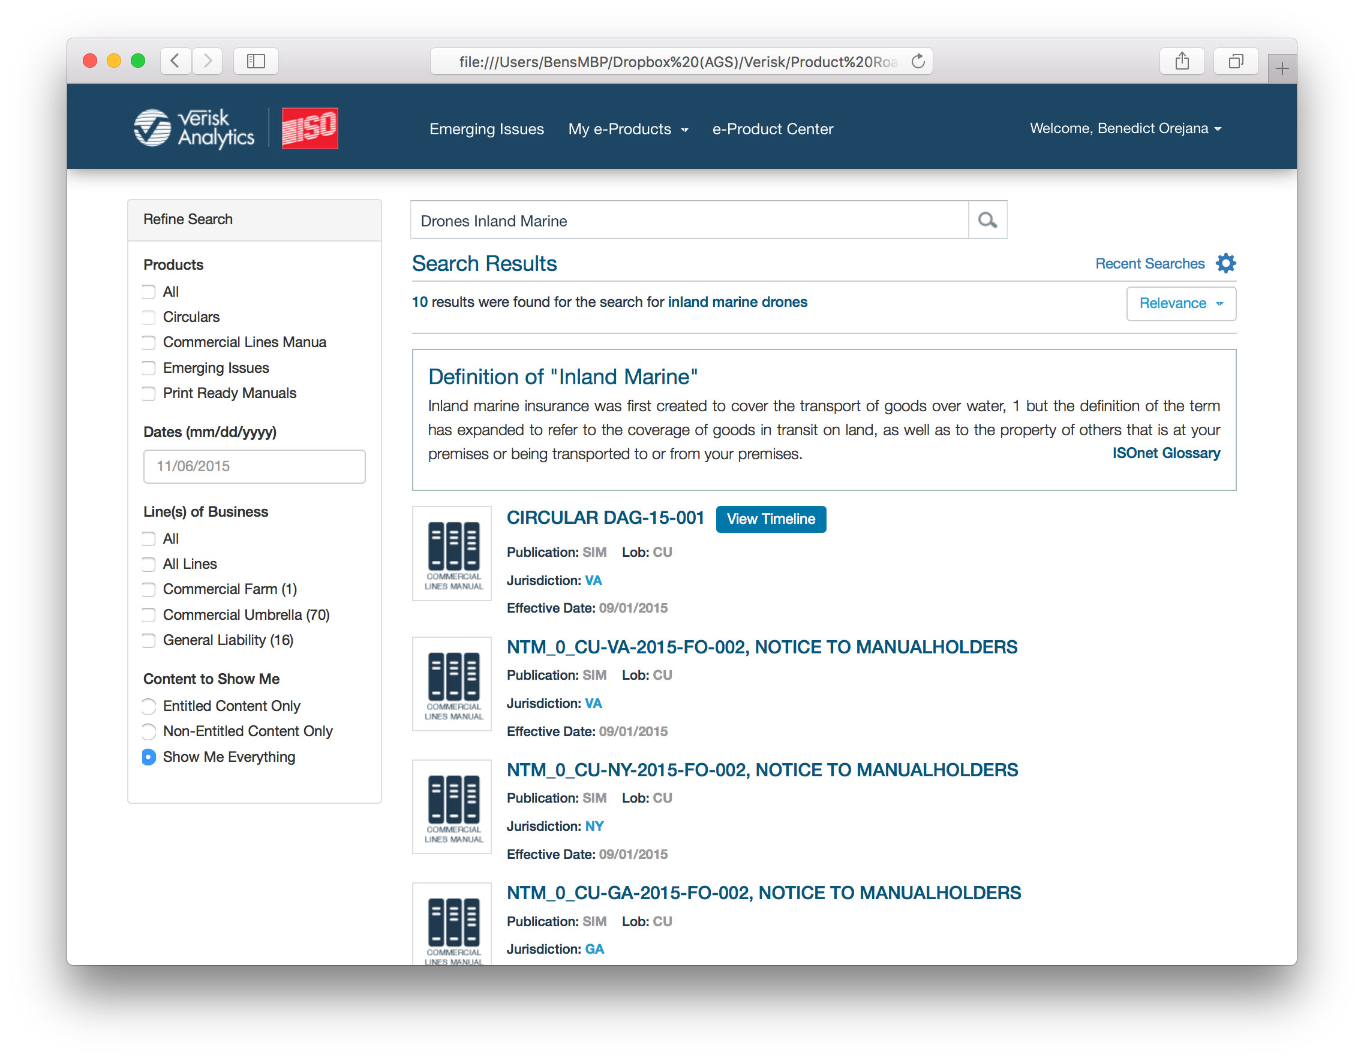
Listings pages (search results)
Listing pages will follow the same layout as the current Global Search including:
Facets Panel (1) located on the left
Result listing (2) in the primary content area.
If the search term also matches a term in the ISOnet Glossary, the best matched definition will be listed at the top of the search results (3). Only one definition will be displayed for any given query.

Slide 16
Search input box – scroll behavior
The search input box is displayed at the top of the search results page(1) by default.
When the user scrolls down the result set and the input box is scrolls out of view, the search input box becomes active in the global navigation (2)
1
Drones Inland Marine
2

Slide 17
Content Page – Pop-up
Links to external PDF files can be displayed in a modal window. The PDF viewer offers controls to browse or download the file.

Slide 18
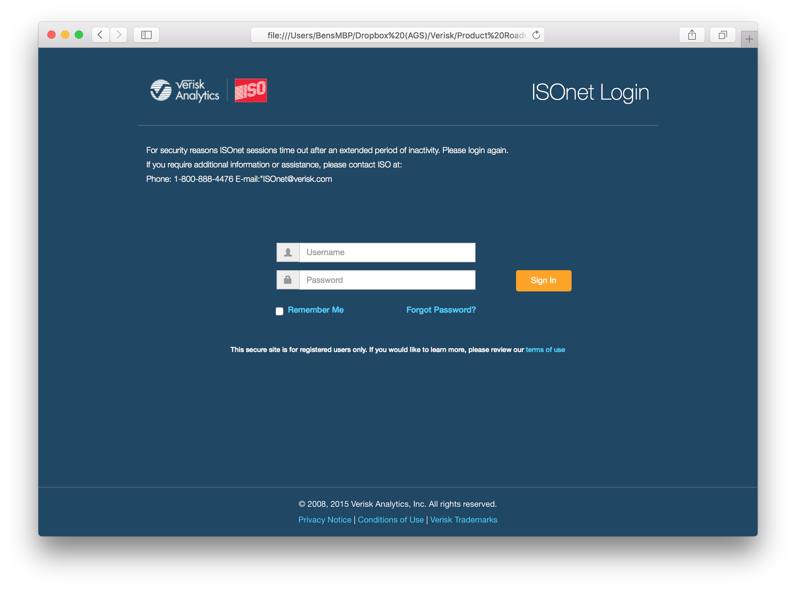
Ancillary Page: User Authentication

Slide 19
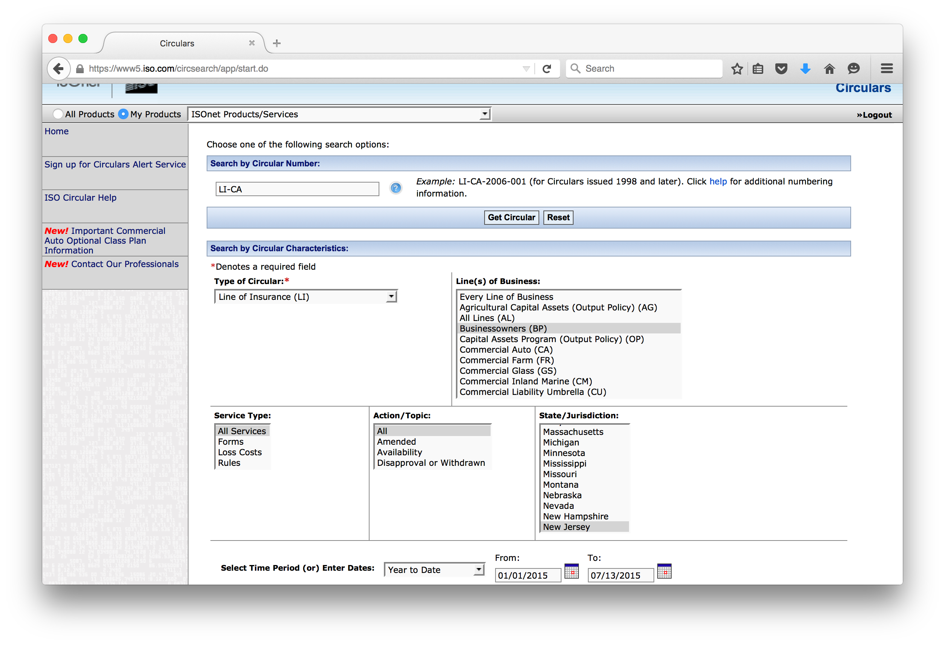
Embedding existing apps
An example of adopting the ISOnet navigation with an existing application. The navigation allows access to other e-Products as well as the global search.
Welcome, Ben Orejana
Circulars
Enter search term
X

Slide 20
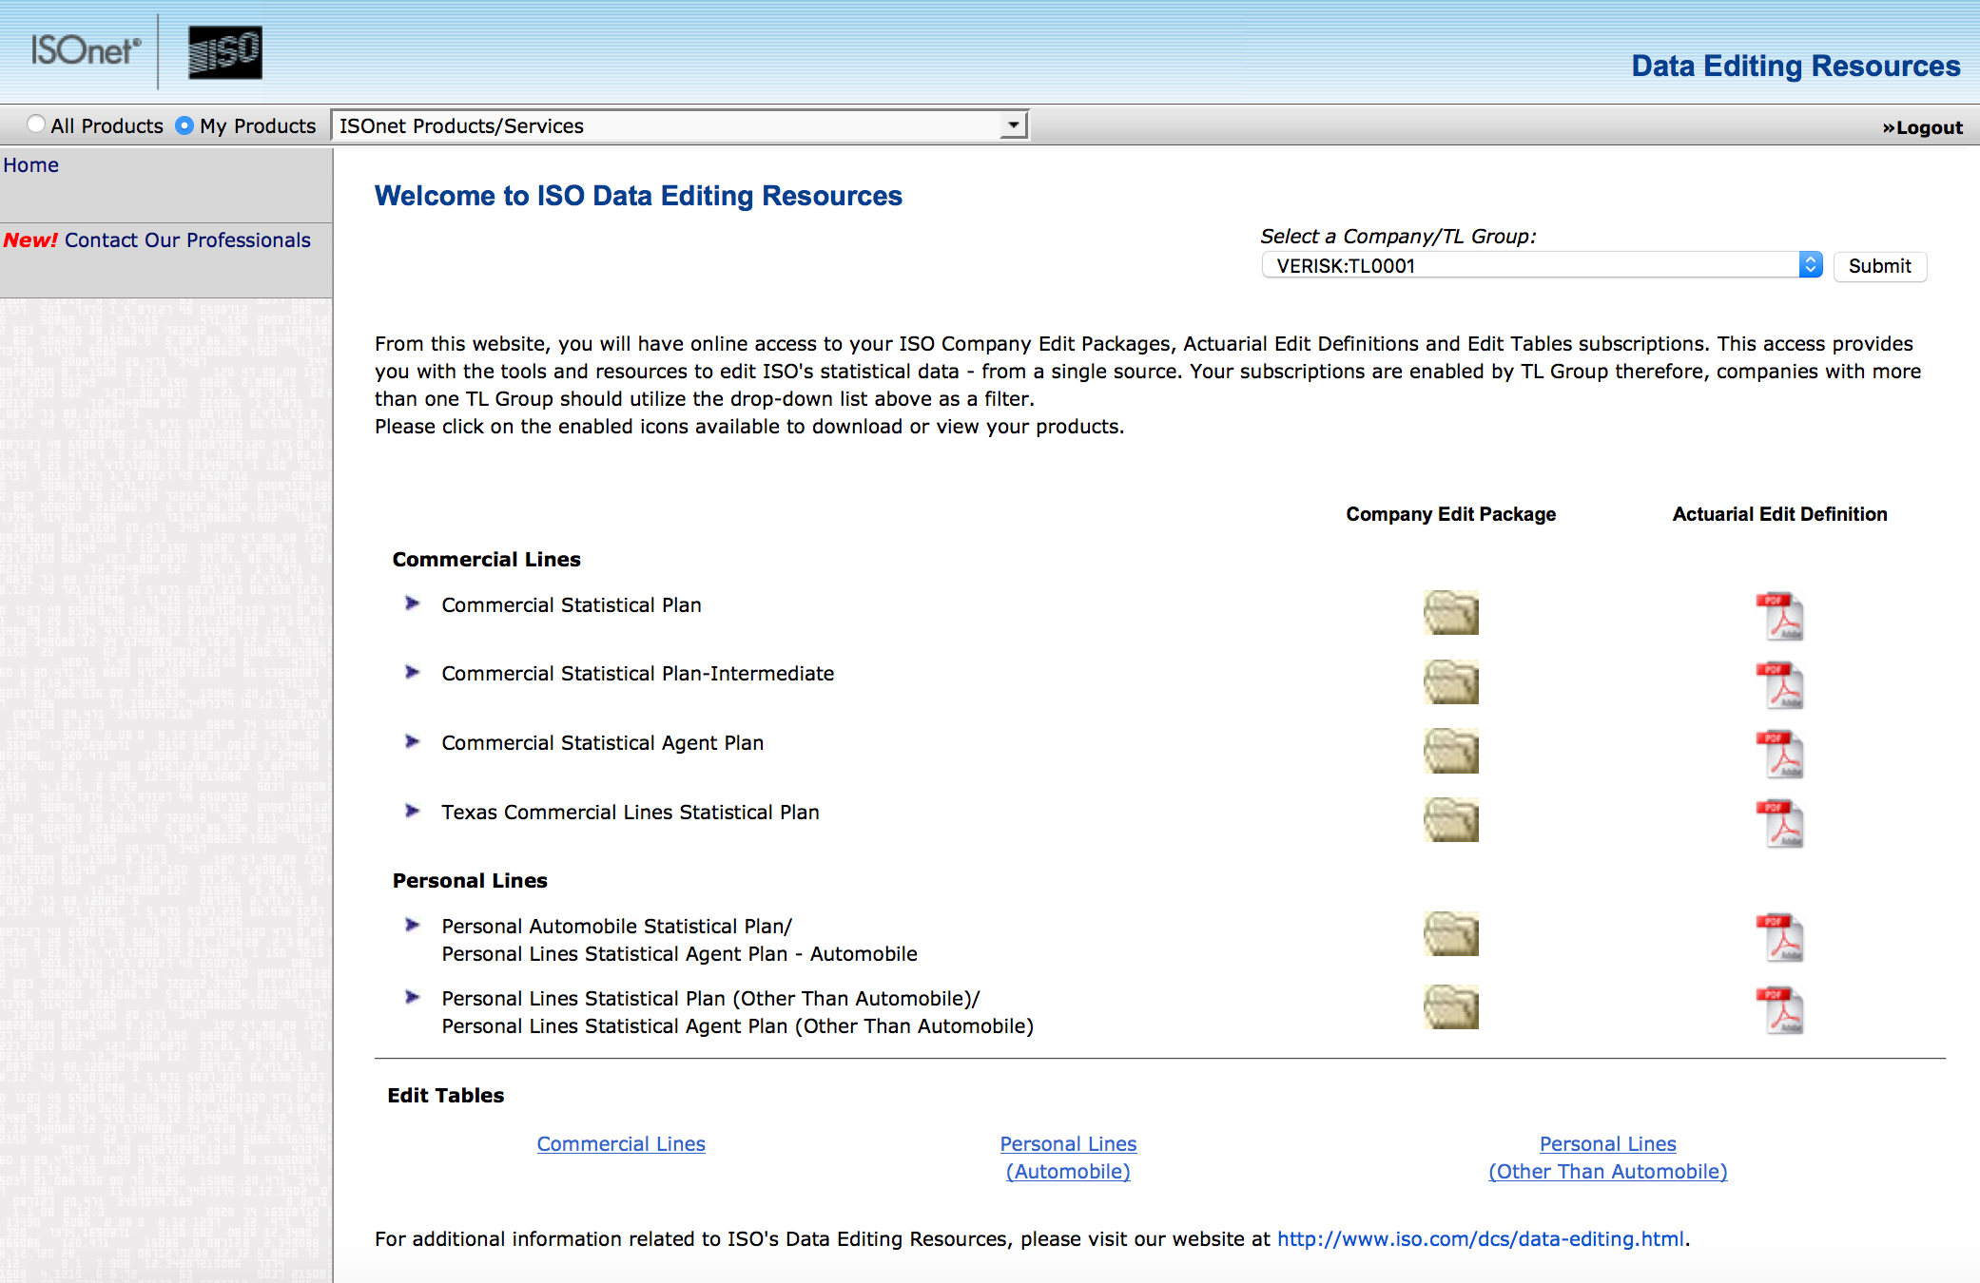
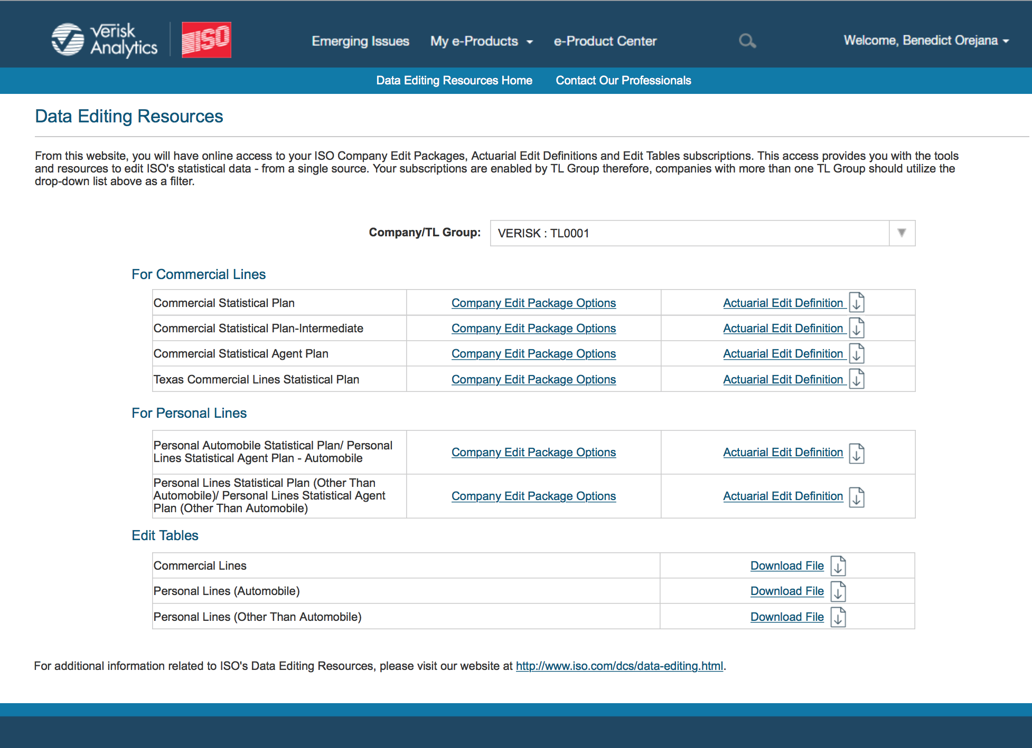
Styling Existing Apps
ISOnet applications will need to be evaluated and styled to match the new ISOnet style guide.

Slide 21
Ben Orejana - UX Lead
Dan DiFlavis – UX Designer / Product Strategist
About Alliance
The fastest growing provider of software development services, Alliance Global Services partners with organizations across all industries on their mission-critical software. Our team of more than 1,000 designs, develops, and tests the applications, platforms, and products that become primary drivers of innovation, competitive differentiation, and revenue growth for clients. At Alliance, we believe that every company is in the software business and transform our clients’ businesses with great software – the software that lives inside their businesses and has an impact every day. Alliance Global Services is headquartered outside of Philadelphia in Conshohocken, PA.
linkedin.com/company/alliance-global-services

